Slide 1
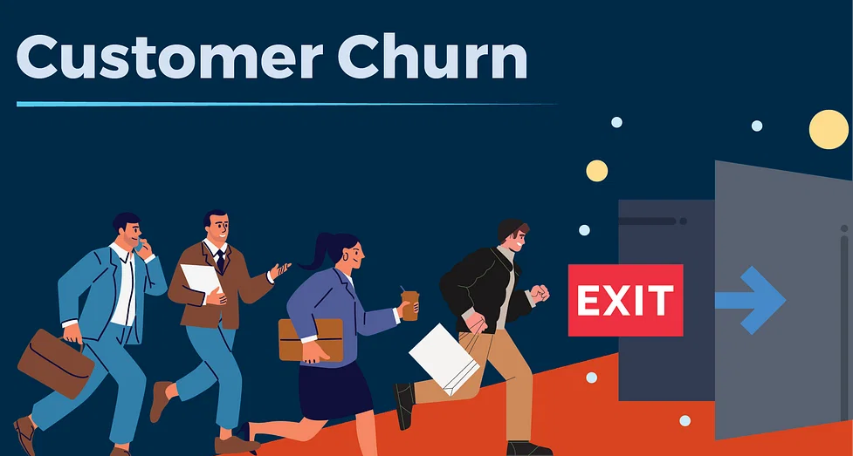
Minor Project
Title: Churn Rate Prediction

Slide 2
Table of Contents
Introduction
Objectives
Methodology
Results
SHAP Results
Conclusion
References

Slide 3
Introduction
TECHNICAL BACKGROUND OF PROJECT:
Customer churn is a significant challenge faced by businesses across industries. The ability to predict which customers are likely to discontinue their service or product subscription can help companies take proactive measures to retain them and reduce revenue loss.
PROBLEM STATEMENT:
Companies have a significant problem with customer churn. To solve this problem, companies need to identify the customers who are likely to churn and take pre-emptive measures to retain them.
AREA OF APPLICATIONS:
Telecommunications, banking and finance, and subscription services.
DATASET:
TELECOM CHURN

Slide 4
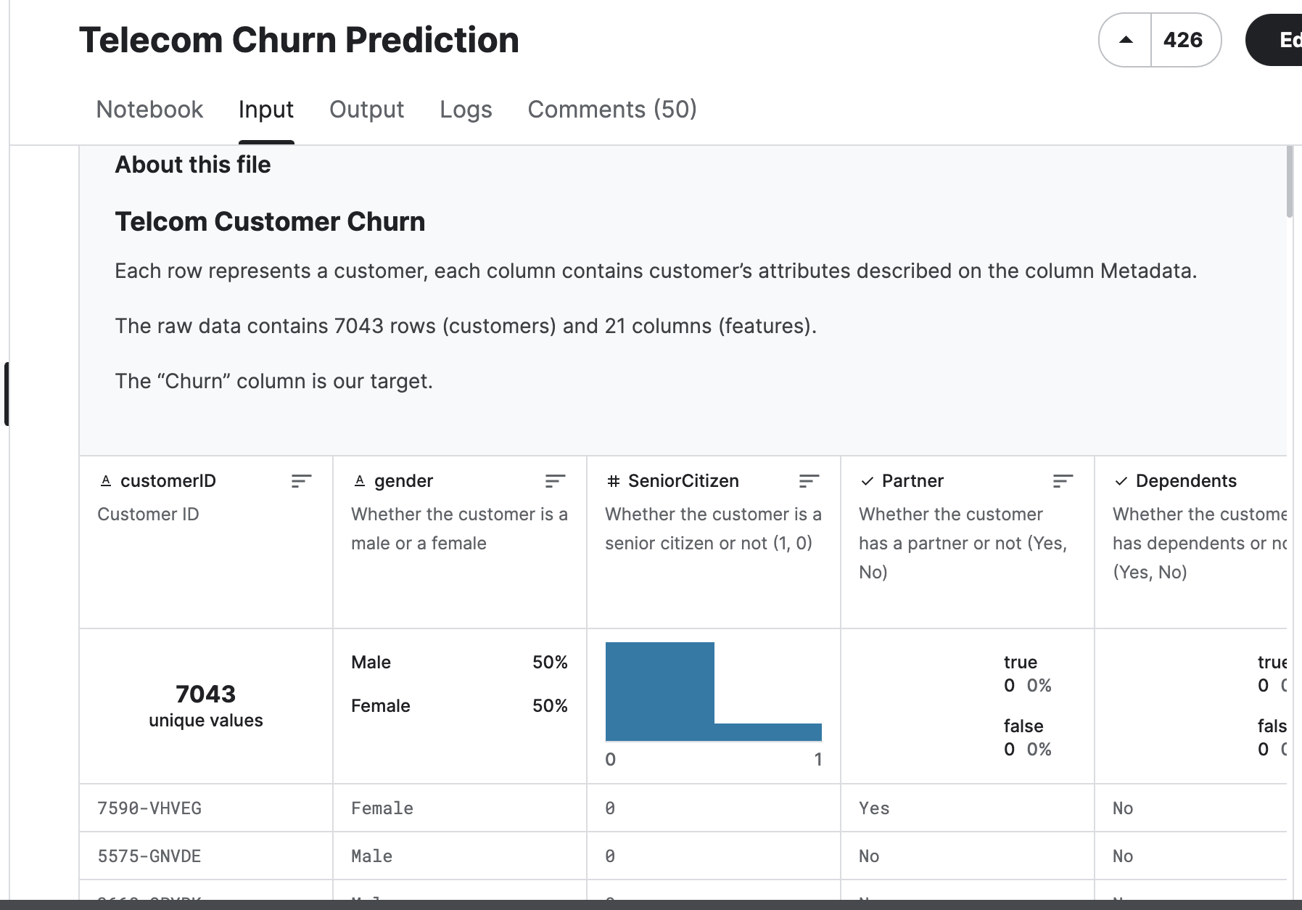
DATASET

Slide 5

OBJECTIVES
To develop a predictive model to estimate the customer churn rate for a telecommunications company.
To identify key factors influencing customer churn, to enhance the accuracy and relevance of the predictive model.
To evaluate the effectiveness of different machine learning algorithms in predicting customer churn.
Assess the model’s explainability and interpretability to enhance the churn rate using Artificial Intelligence.

Slide 6
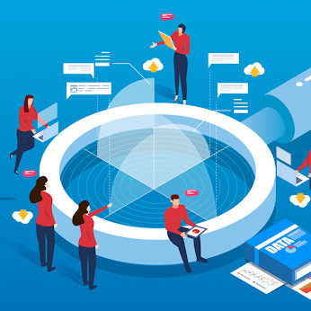
METHODOLOGY

Slide 7
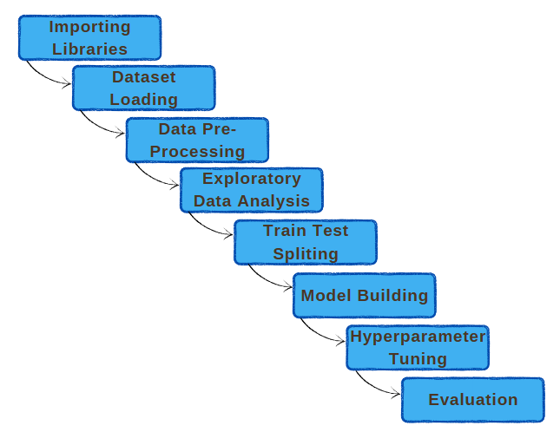
FLOWCHART

Slide 8
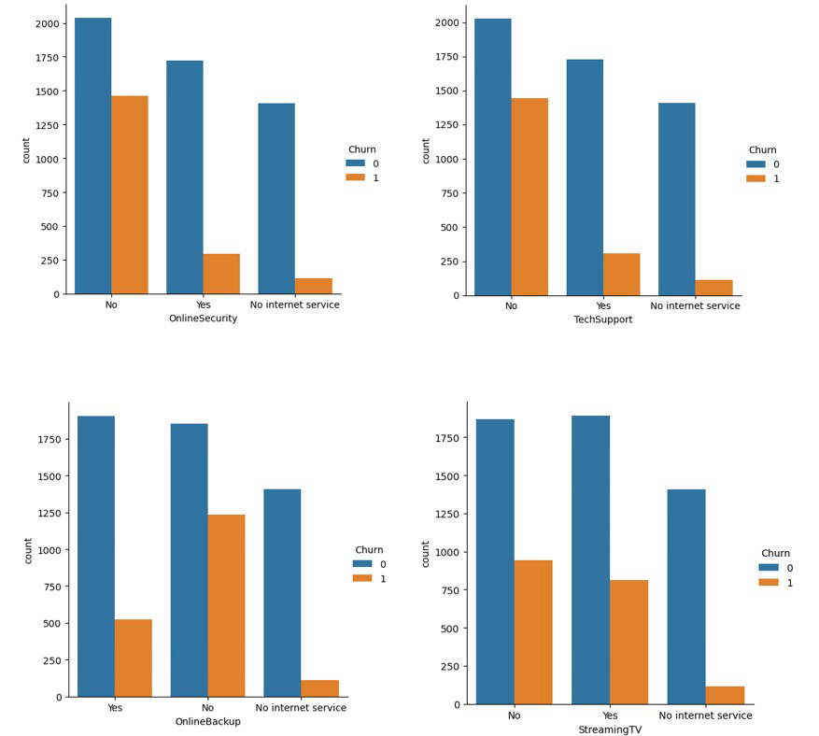
COUNT OF DATA VALUES

Slide 9

RESULTS

Slide 10

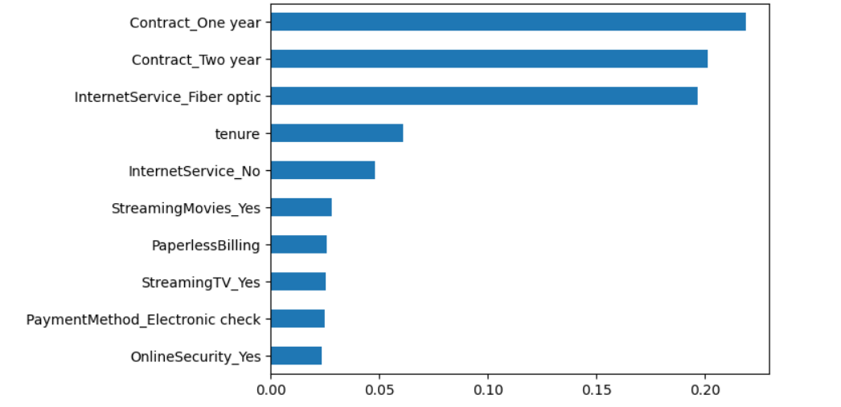
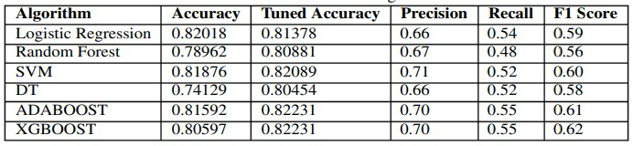
PREDICTION RESULTS

Slide 11
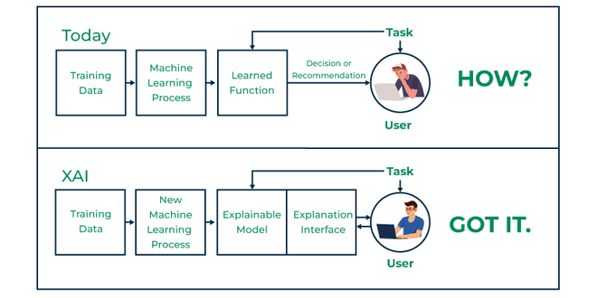
Explainable artificial intelligence(XAI)
Explainable artificial intelligence(XAI) is a process and a set of methods that helps users by explaining the results and output given by AI/ML algorithms.

Slide 12
USING XAI IN CHURN PREDICTION (SHAP)
SHAP Explainer: Utilize SHAP (SHapley Additive exPlanations) to create an explainer for your trained model, which calculates the contribution of each feature to the prediction.
Feature Attribution: Use SHAP values to attribute the contribution of individual features to each prediction, providing a clear understanding of why the model predicts a customer will churn or not.
Visualization: Generate SHAP visualizations like dependency plots to interpret and communicate the influence of features on churn predictions, aiding in decision-making and strategy formulation.

Slide 13
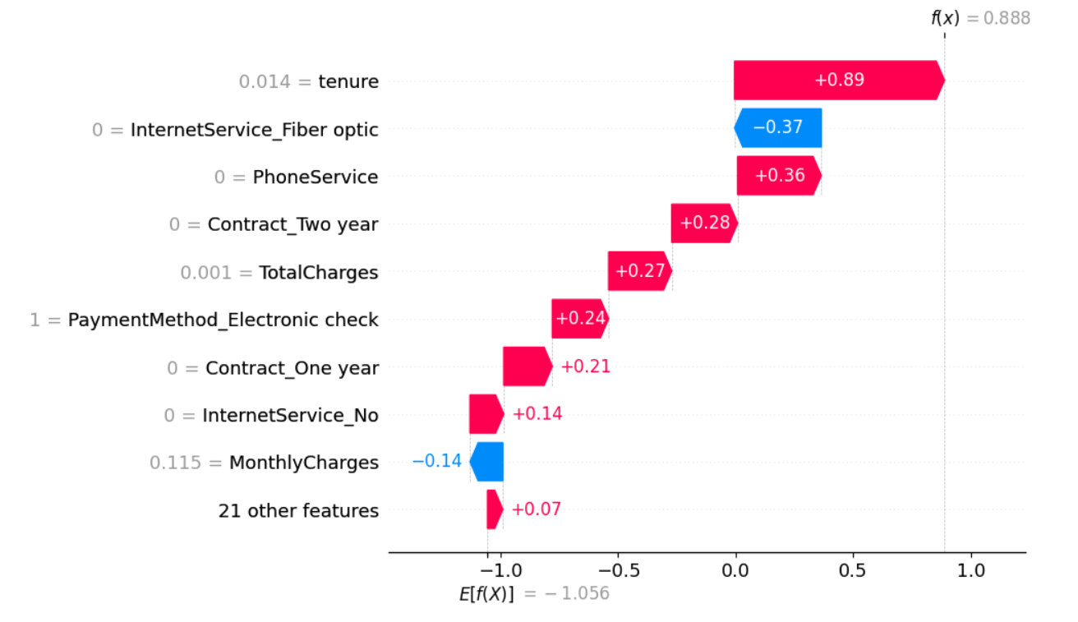
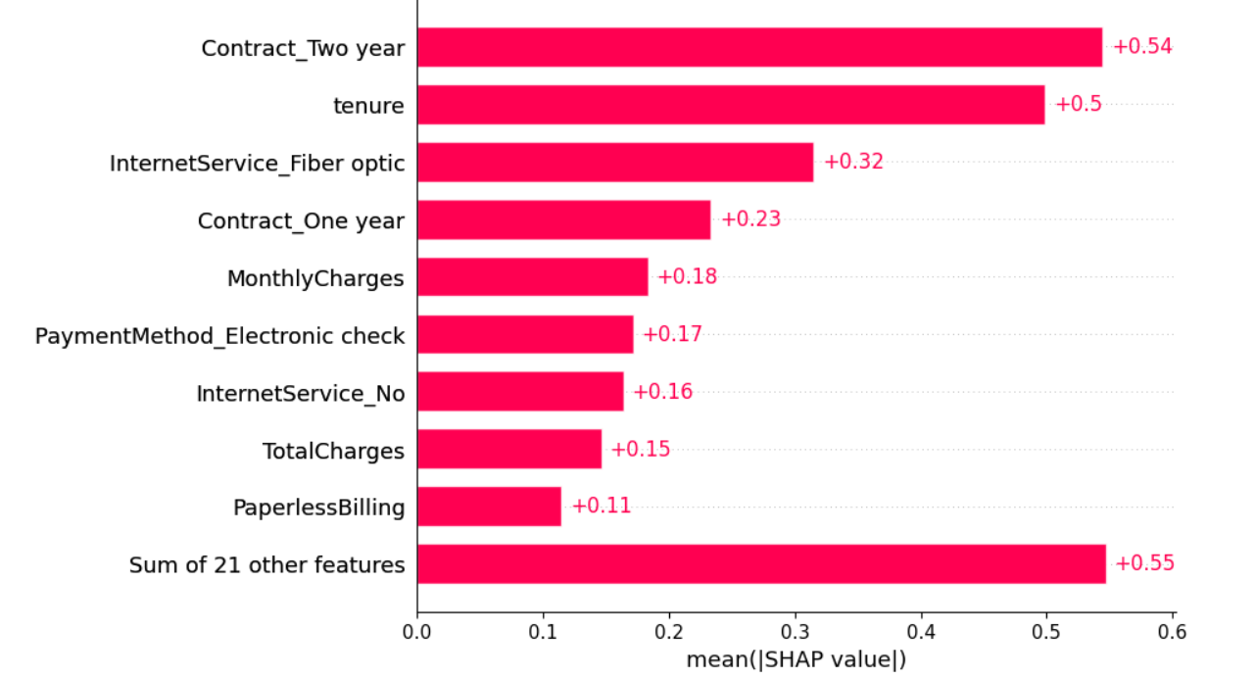
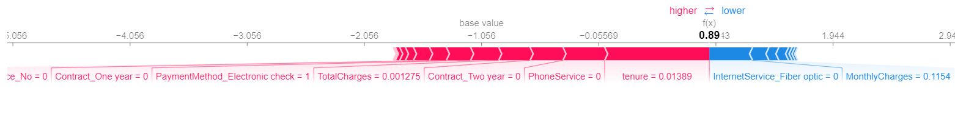
SHAP RESULTS

Slide 14
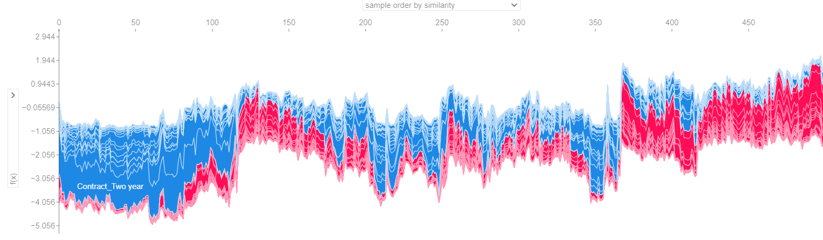
SHAP RESULTS

Slide 15
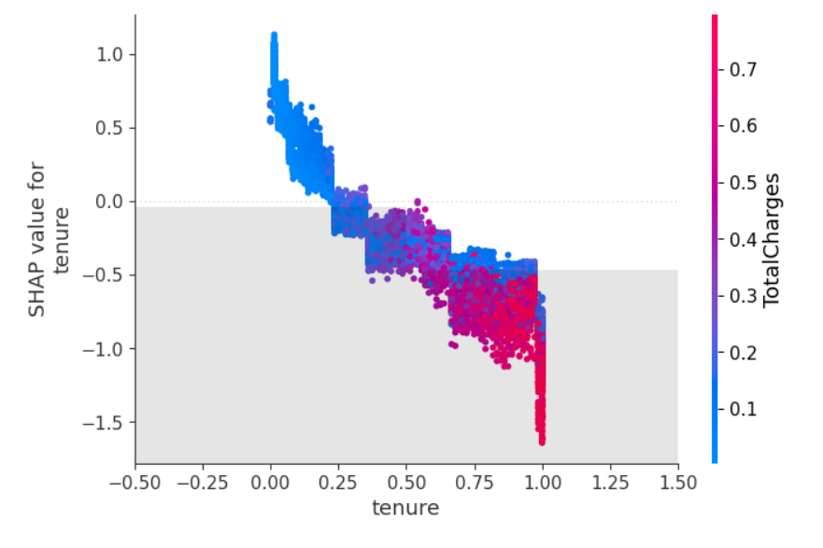
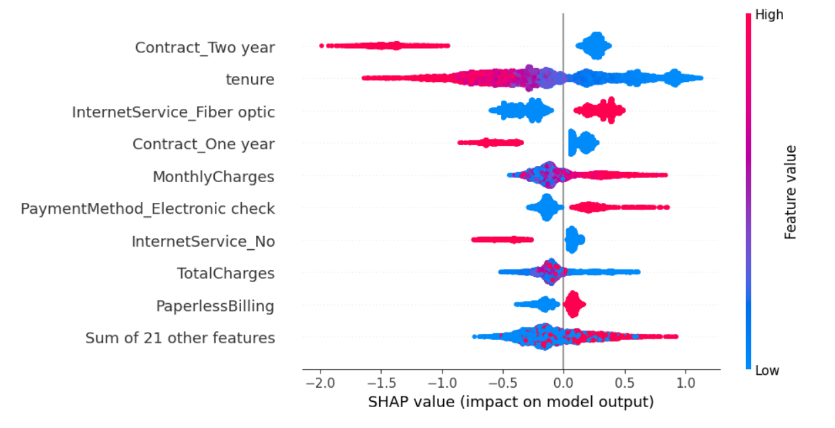
SHAP RESULTS

Slide 16
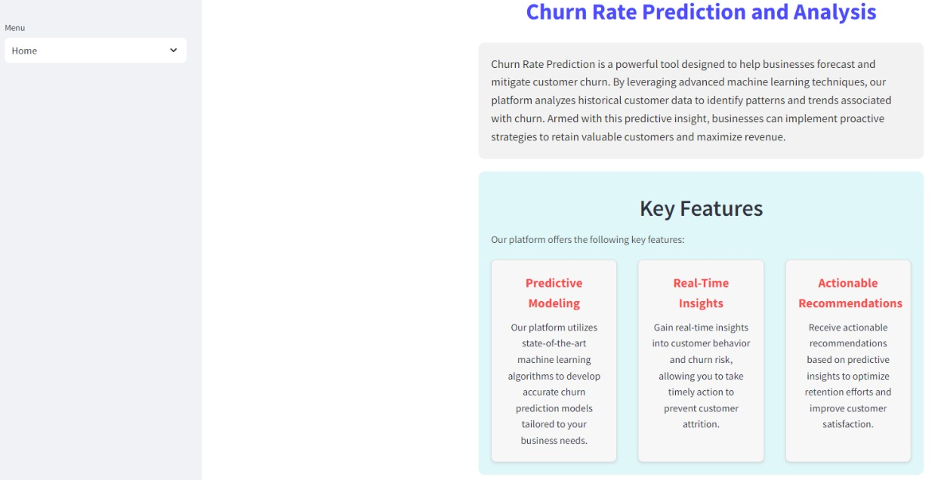
WEB APP DEVELOPMENT WITH STREAMLIT
It simplifies the process of building web apps by allowing users to write Python scripts that automatically generate the app's user interface.
Easy to Use:
Write simple Python scripts to create interactive web apps.
Interactive Widgets:
Use sliders, buttons, and text inputs for real-time updates.
Data Science Integration:
Seamlessly works with Pandas, NumPy, and visualization libraries like Matplotlib and Plotly.

Slide 17
REFERENCES
References
[1] S. K. Wagh, A. A. Andhale, K. S. Wagh, J. R. Pansare, S. P. Ambadekar, and S. H. Gawande, “Customer churn prediction in telecom sector using machine learning techniques,” Results in Control and Optimization, vol. 14, 3 2024.
[2] A. Amin, A. Adnan, and S. Anwar, “An adaptive learning approach for customer churn prediction in the telecommunication industry using evolutionary computation and na ̈ıvebayes,” Applied Soft Computing, vol. 137, 4 2023.
[3] J. Maan and H. Maan, “Customer churn prediction model using explainable machine learning,” International Journal of Computer Science Trends and Technology, vol. 11, 2023.
[4] A. K. Ahmad, A. Jafar, and K. Aljoumaa, “Customer churn prediction in telecom using machine learning in big data platform,” Journal of Big Data, vol. 6, 12 2019.
[5] B. Prabadevi, R. Shalini, and B. R. Kavitha, “Customer churning analysis using machine learning algorithms,” International Journal of Intelligent Networks, vol. 4, pp. 145–154 2023.
[6] L. Saha, H. K. Tripathy, T. Gaber, H. El-Gohary, and E. S. M. El-kenawy, “Deep churn prediction method for telecommunication industry,” Sustainability (Switzerland), vol. 15, 3,2023.
[7] A. Khattak, Z. Mehak, H. Ahmad, M. U. Asghar, M. Z. Asghar, and A. Khan, “Customer churn prediction using composite deep learning technique,” Scientific Reports, vol. 13, 12 2023.
[8] “Retraction: A prediction model of customer churn considering customer value: An empirical research of telecom industry in china (discrete dynamics in nature and society (2021) 2021 (7160527) doi: 10.1155/2023/7160527),” 2023.
[9] Atindrabandi, “Wa fn-usec -telco-customer-churn,” 2019-21.

Slide 18

THANK YOU

